Slide 1
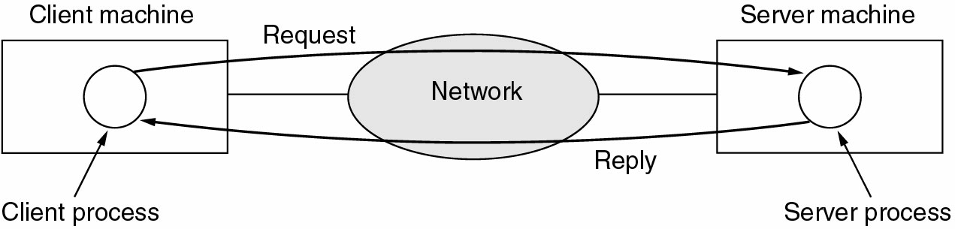
Business Applications of Networks
The client-server model involves requests and replies

Slide 2
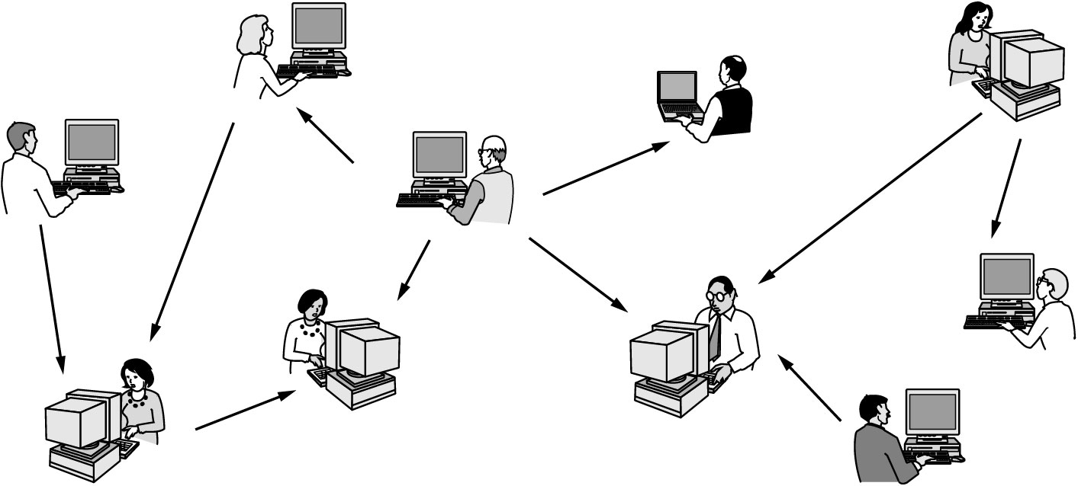
Home Network Applications
In peer-to-peer system there are no fixed clients and servers

Slide 3
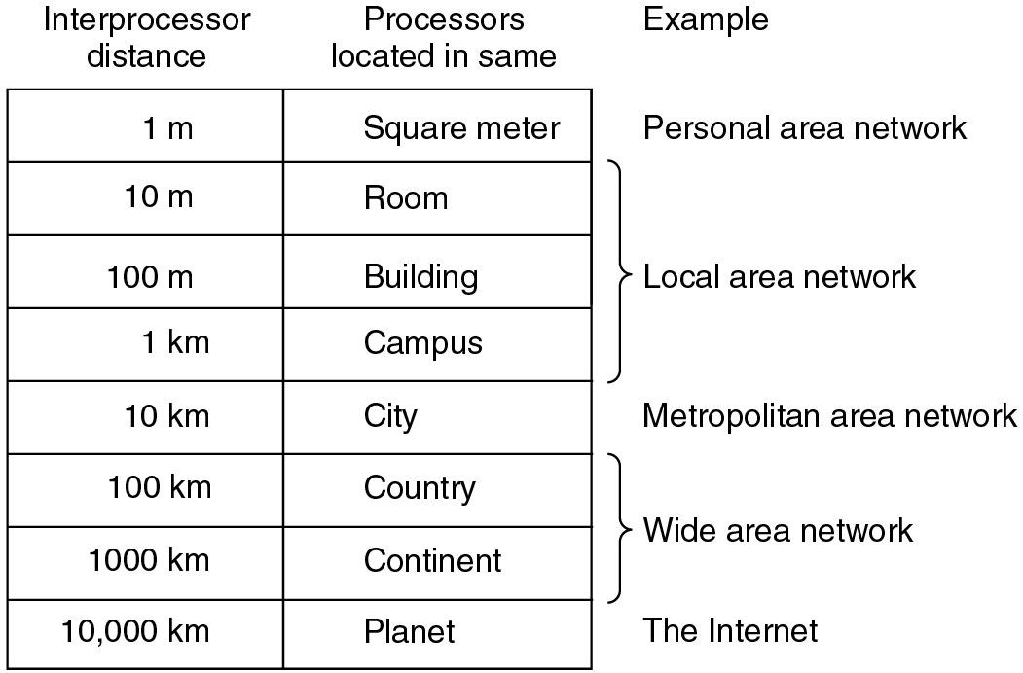
Broadcast Networks Example
Classification of interconnected processors by scale

Slide 4
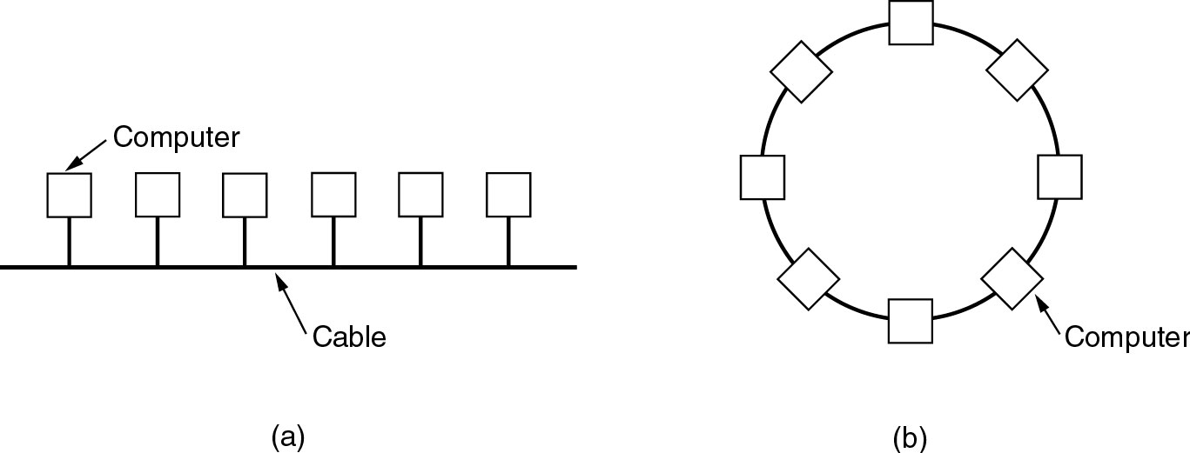
Local Area Networks
Two broadcast networks
  (a) Bus
  (b) Ring

Slide 5
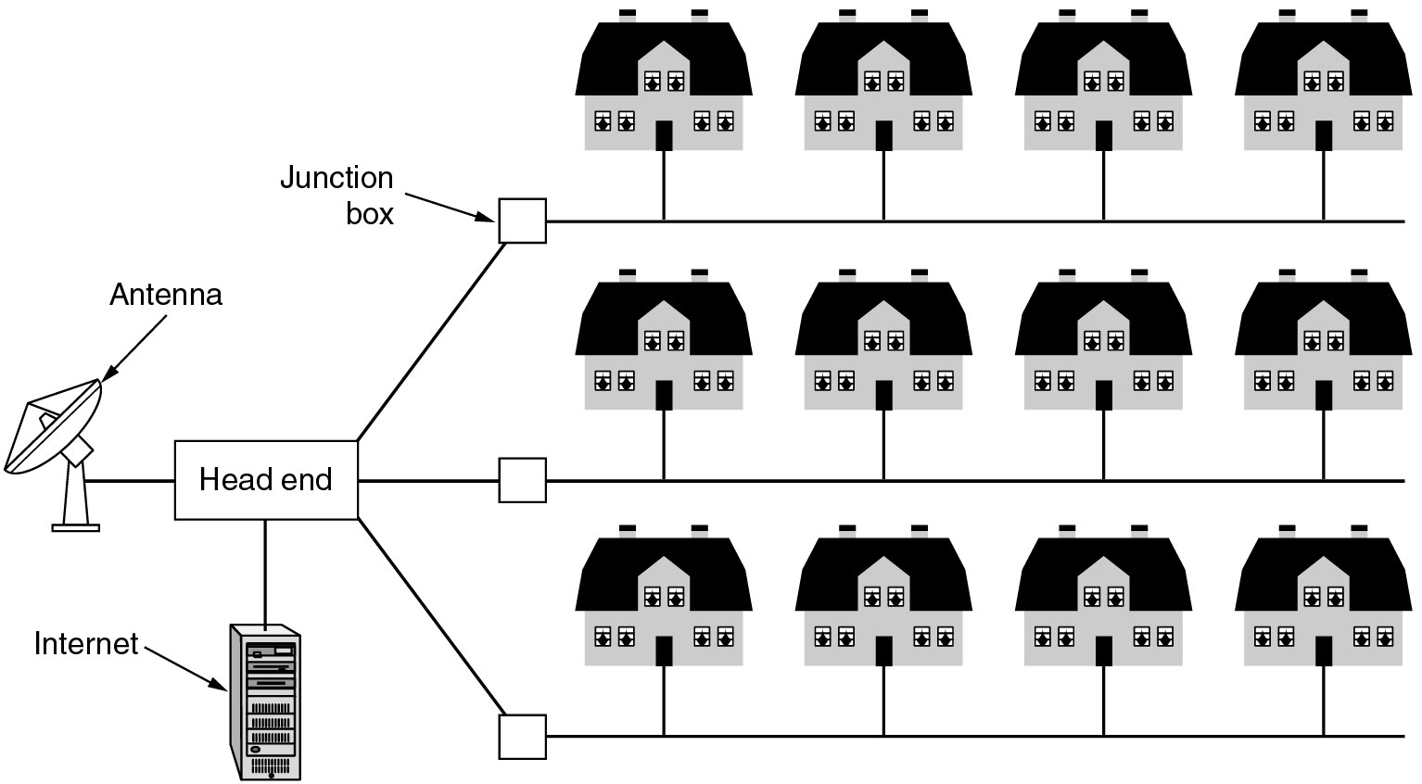
Metropolitan Area Networks
A metropolitan area network based on cable TV

Slide 6
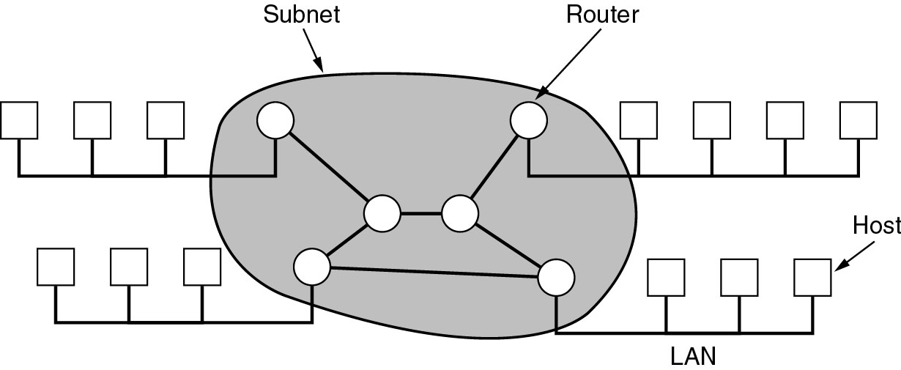
Wide Area Networks
Relation between hosts on LANs and the subnet

Slide 7
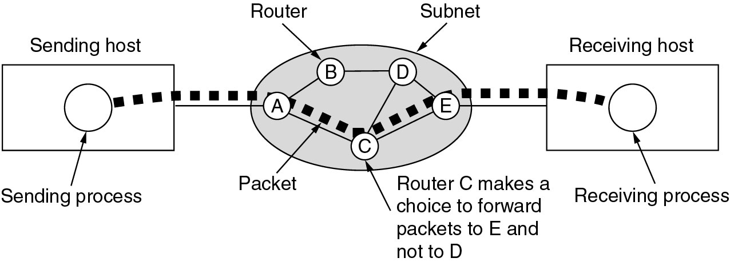
Wide Area Networks
A stream of packets from sender to receiver

Slide 8
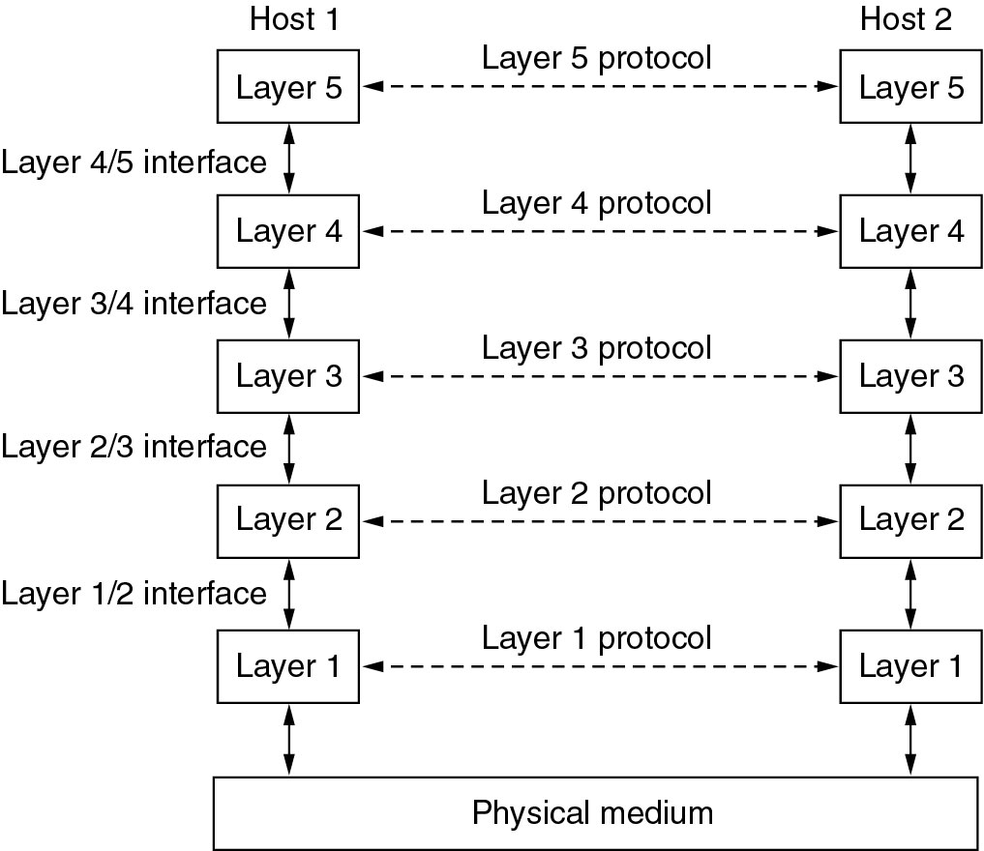
Network Software
Networks are structured in layers

Slide 9
Protocol Hierarchies
Layers (levels)
  Offers specific services to higher layers
    Information hiding
  Network characterization
    Number of layers
    Name of each layer
    Contents of each layer
    Function of each layer

Slide 10
Protocol Hierarchies
Layer n on one machine communicates with layer n on another machine

Slide 11
Network Software Protocol Hierarchies
Layer n communication process
Virtual communication
Physical communication

Slide 12
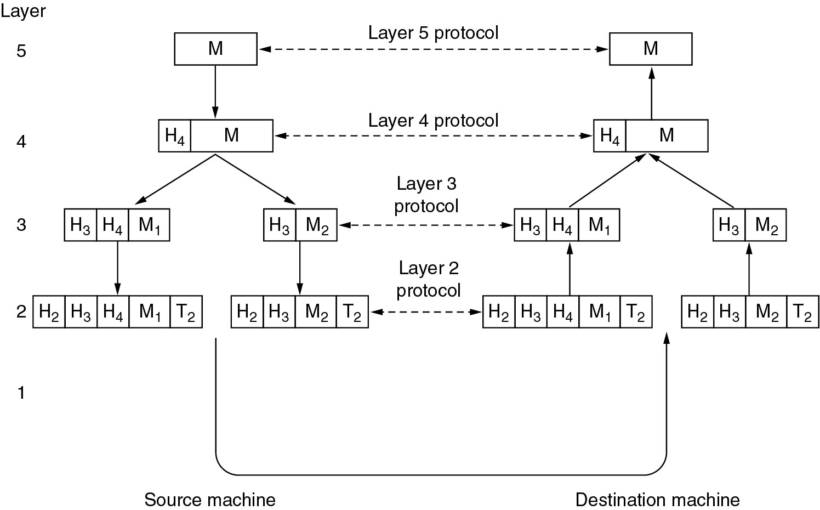
Protocol Hierarchies Example
Example information flow supporting virtual communication in layer 5

